Slide 1

Blood Bank Management System
Presented by:
Md Razib Hossain
Id:UG02-49-18-005

Slide 2

Purpose:
The purpose of the blood bank management system is to simplify and automate the process of searching for blood in case of emergency and maintain the records of blood donors ,recipient ,blood donation programs and blood stocks in the bank.

Slide 3
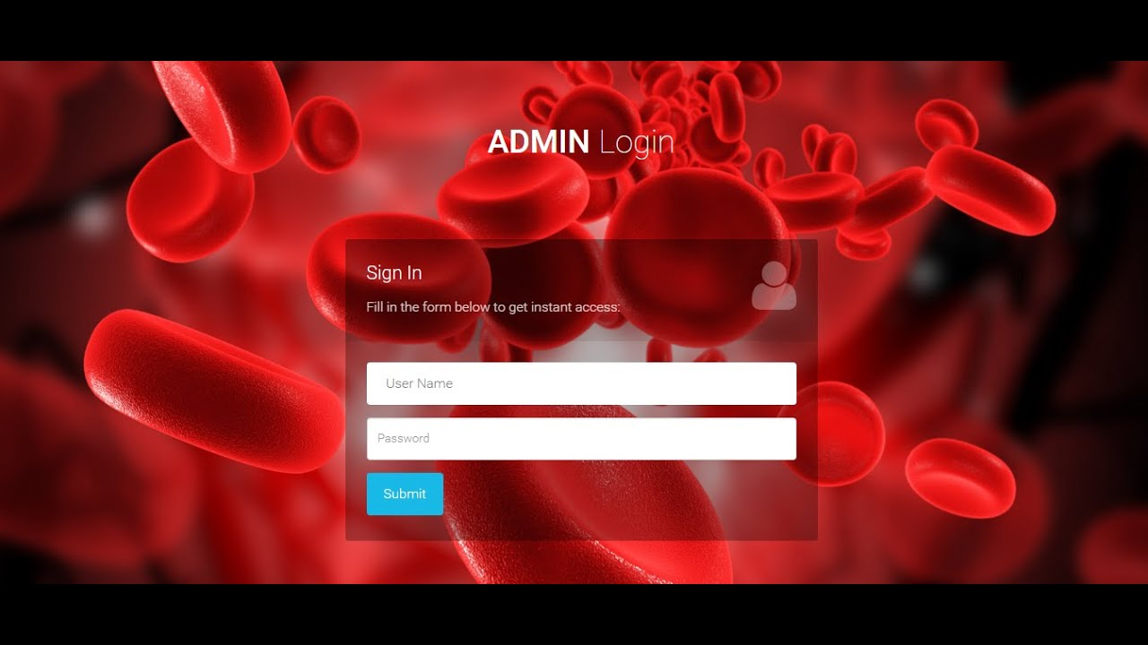

Slide 4

Data about Donor and recipient Id:
Donation Program
1.Donor/Recipient id
2.Name
3.Date of birth
4.Sex
5.Blood Group
6.Address
7.Contact number
8.Email Address
9.Blood id
10.Event id
1.Organizer
2.Event id
3.Date of Donation
4.Venue
5.Volunteers
6.Amount of blood collected
Staff
Blood
1.Blood id
2.Blood Group
3.Date of collection
4.Expire date
1.Staff id
2.Name
3.User Name
4.Password

Slide 5

Software Requirements:
Operating System – Windows 7 or HigherApache Server
(UWAMP/XAMMP)BootstrapphpMyadmin
HTML
Cascading Style Sheet(CSS)

Slide 6

Thank You

